Slide 1
NATIONAL CLINICAL TRIAL STRATEGIC PLAN (NCTSP)

Slide 2
Who is The National Black Church Initiative and The American Clinical Health Disparities Commission?

Slide 3
WHO WE ARE: The National Black Church Initiative (NBCI)
The National Black Church Initiative (NBCI) is a coalition of 150,000 African American and Latino churches constituting 27.7 members working to eradicate racial disparities in healthcare, technology, education, housing, and for all its members, congregants, churches, and the public.
The mission of NBCI is to provide critical wellness information to all its members, congregants, churches, and the public. NBCI’s methodology utilizes faith-sound health science and critical wellness information to science and partners with major organizations and officials to reduce racial disparities in the variety of areas cited above.

Slide 4
WHO WE ARE: The National Black Church Initiative (NBCI)
NBCI's programs are governed by credible statistical analysis, science-based strategies and techniques, and methods that work and offer faith-based, out-of-the-box and cutting-edge solutions to stubborn economic and social issues. https://www.naltblackchurch.com

Slide 5
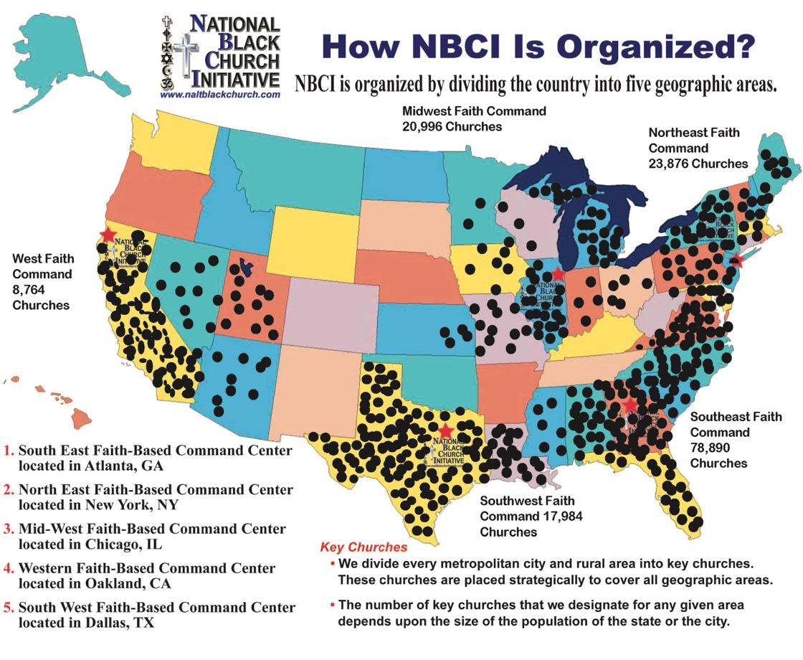
NBCI Demographic Reach
Below is the map of NBCI constituencies throughout the various regions of the country:

Slide 6
WHAT WE DO: MISSION FORWARD
NBCI and the American Clinical Health Disparities Commission (ACHDC) are ushering in a new era of broadened engagement of African American and Latino communities in clinical trials.
ACHDC is a coalition of African American and Latino clinicians and African American church leaders.
Particularly given the unethical and illegal behaviors involved with the Tuskegee Experiment and the intentional absence or lack of critical information for the involved subjects by governmental officials, NBCI engages in a comprehensive approach to utilize important lessons learned from historic medical abuses for generating robust interest in substantially improving clinical trial participation.

Slide 7
Why NBCI: Infrastructural Capacity for Implementing Programs
NBCI has a Clinical team of 42 African American physicians to bring to bear.
NBCI is the largest faith-based preventative health initiative in the country.
NBCI has successfully been conducting clinical health prevention programming over the past 30 years.
NBCI created and completed a successful clinical lecture tour of Black and Latino researchers talking the importance of clinical trials.

Slide 8
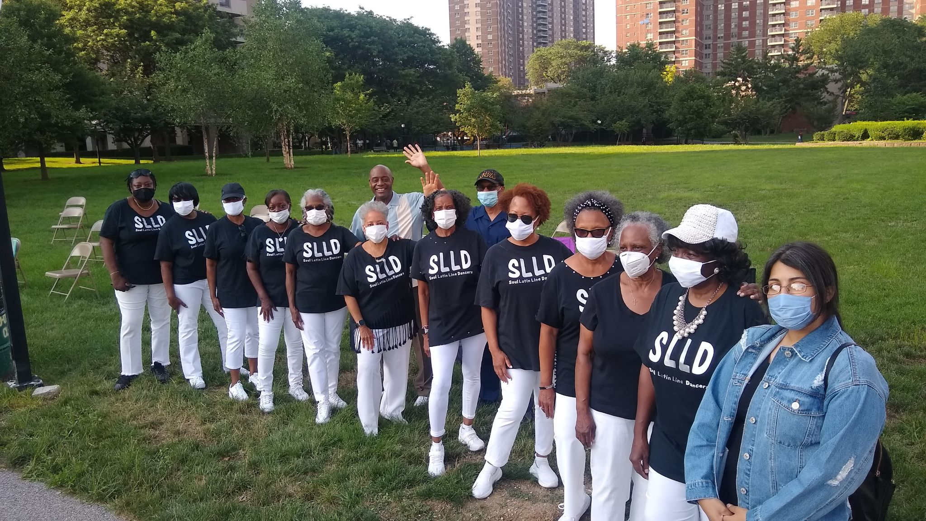
What is the Issue? Clinical Trails Pav

Slide 9
Diversity Plans to Improve Enrollment of Participants From Underrepresented Racial and Ethnic Populations in Clinical Trials
The FDA are currently writing rules that require diversity in all clinical trials moving forward.
African Americans morbidity and mortality continue to move an unprecedented rate over the past two decades.
African American and Latino clinicians attribute this to the lack of participation in clinical trials to answer the question, “Why?”

Slide 10
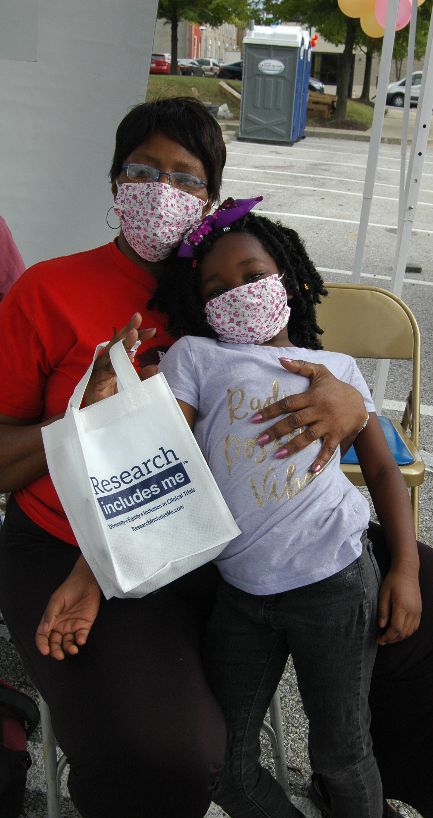
What is NBCI’s and ACHDC’s Solution
Over the past ten years NBCI has built an infrastructure to support the goals and objectives under the National Clinical Trial Strategic Plan

Slide 11
The American Clinical Health Disparities Commission (ACHDC)
NBCI has created the infrastructure for the first time in the history of this country to deliver in a systematic way critical clinical trial education to its’ 27.7 million members and the Latino community.
This will be the largest health educational effort ever by a 150,000-member faith-based coalition.
We have teamed up with African American and Latino clinicians and have constructed a clinical trial curriculum that will be delivered to millions of church goers.
We will do this under a forthcoming organization called The American Clinical Health Disparities Commission (ACHDC)

Slide 12
NBCI and the ACHDC Website
NBCI has created the first of its’ kind – a comprehensive website that will walk African Americans and Latinos through the basic education of the benefits and risks of clinical trials. blackchurchclinicaltrials.com
There is a comprehensive workbook and an ability to ask questions to clinicians who look like them about the risks and benefits of clinical trials and their overall value to their own health and the health of their people.
blackchurchclinicaltrials.com was created by African American and Latino clinicians and clergy and has been analyzed through comprehensive focus groups consisting of both African Americans and Latinos
Presently it’s being evaluated by 25,000 low-income African Americans and Latinos to evaluate their knowledge base on clinical trials

Slide 13
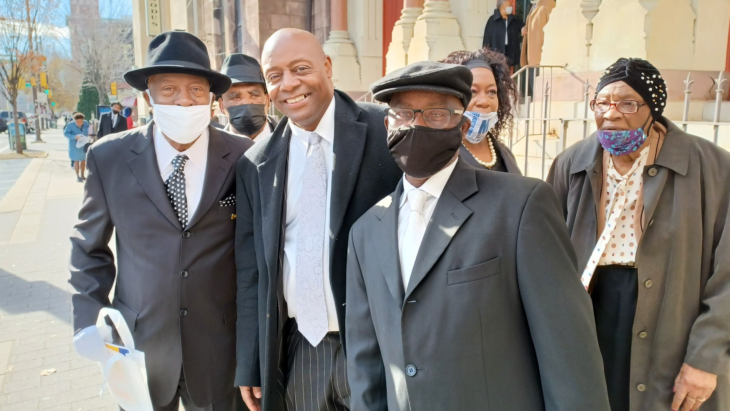
What is the Ask?

Slide 14
WHAT IS THE ASK?
NBCI is seeking a $5 million grant over the next 4 years to support and implement its’ National Clinical Trial Strategic Plan (NCTSP)
https://blackchurchclinicaltrials.com
NCTSP is the most serious, substantive, systematic and science-based attempt by African-American physicians and ministers to persuade the black community of the risks and benefits of participating in clinical trials.

Slide 15
WHAT IS THE ASK?
Many experts agree that by combining faith and science with the largest pool of prospective and educated members and dealing forthrightly with the historical mistrust of science and government this approach has more than an 80% chance of succeeding.
https://blackchurchclinicaltrials.com/faith-health.php

Slide 16
What is the Ask?
A fully funded ask will permit the following activities to take place.
Hiring of an outreach staff
Marketing of the website blackchurchclinicaltrials.com
The development of a comprehensive social media plan
The activation of a “Train the Trainers” program
The implementation of cultural competency clinical education for clinicians
The continuation of the Clinical Trial Mobile Pavilion targeting 15 cities
The implementation of the Clinical Trial Day Long Program
The video production of “How to Successfully Communicate with African American and Latino Patients”

Slide 17
How We Plan to Achieve Our Educational Goals
Conduct 500 to 1,500 education sessions using the Trainer of Trainers methodology to facilitate preparation of the NBCI members.
Engagement with 50,000 to 105,000 NBCI members to educate and encourage annually the need to complete the online clinical trials course.

Slide 18
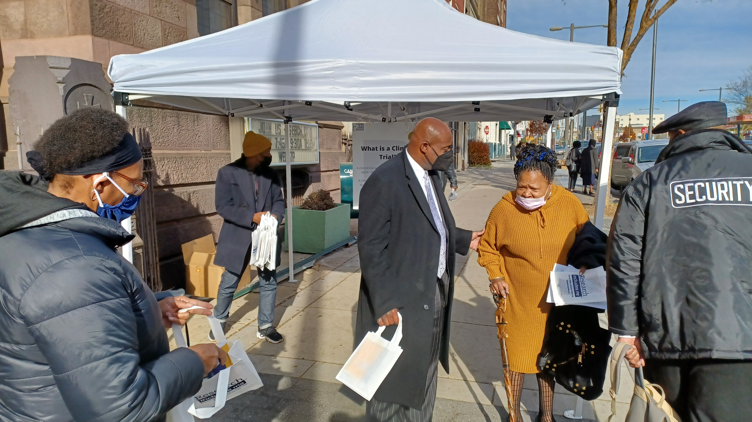
What Has Been Accomplished in This Area To Date

Slide 19
Current Activities: Laying the Ground-Work
NBCI is currently testing its new NCTSP Clinical Trials website with 25,000 low-income members of its churches.
NBCI is briefing:
BIO partners
National Medical Association
National Hispanic Medical Association
NBCI is currently engaging in the process to establish a meetings with:
FDA
NIH
American Heart Association
American Lung Association
American Diabetes Association
large health insurers

Slide 20
PROGRAM DESCRIPTION
Program Goal
To offer comprehensive efforts to enhance the overall health and well-being of African American and Latinos.
Program Objectives
To conduct a needs assessment of 25,000 low–income African Americans and Latinos to determine their health and wellness and their willingness to participate in clinical trials.
To implement educational modules of clinical trials to 100,000 to 150,000 African Americans and Latinos to promote health and wellness.

Slide 21
The Success of the NBCI Clinical Program and Demonstrated Capacity
What We Have Done as NBCI with Current Collaborative Partners…
Since the start of the COVID pandemic, NBCI has engaged in diverse efforts to address the holistic needs of our 27.7 million members.
Our programmatic initiatives have generated critical efforts toward educating African Americans and Latinos about COVID.
Here is the link highlighting one approach NBCI has addressed COVID: https://www.naltblackchurch.com/healthcovid-19.html.
Other videos have been done to show our concerted efforts.
https://www.youtube.com/watch?v=gMiQh5JXw7k&t=275s

Slide 22
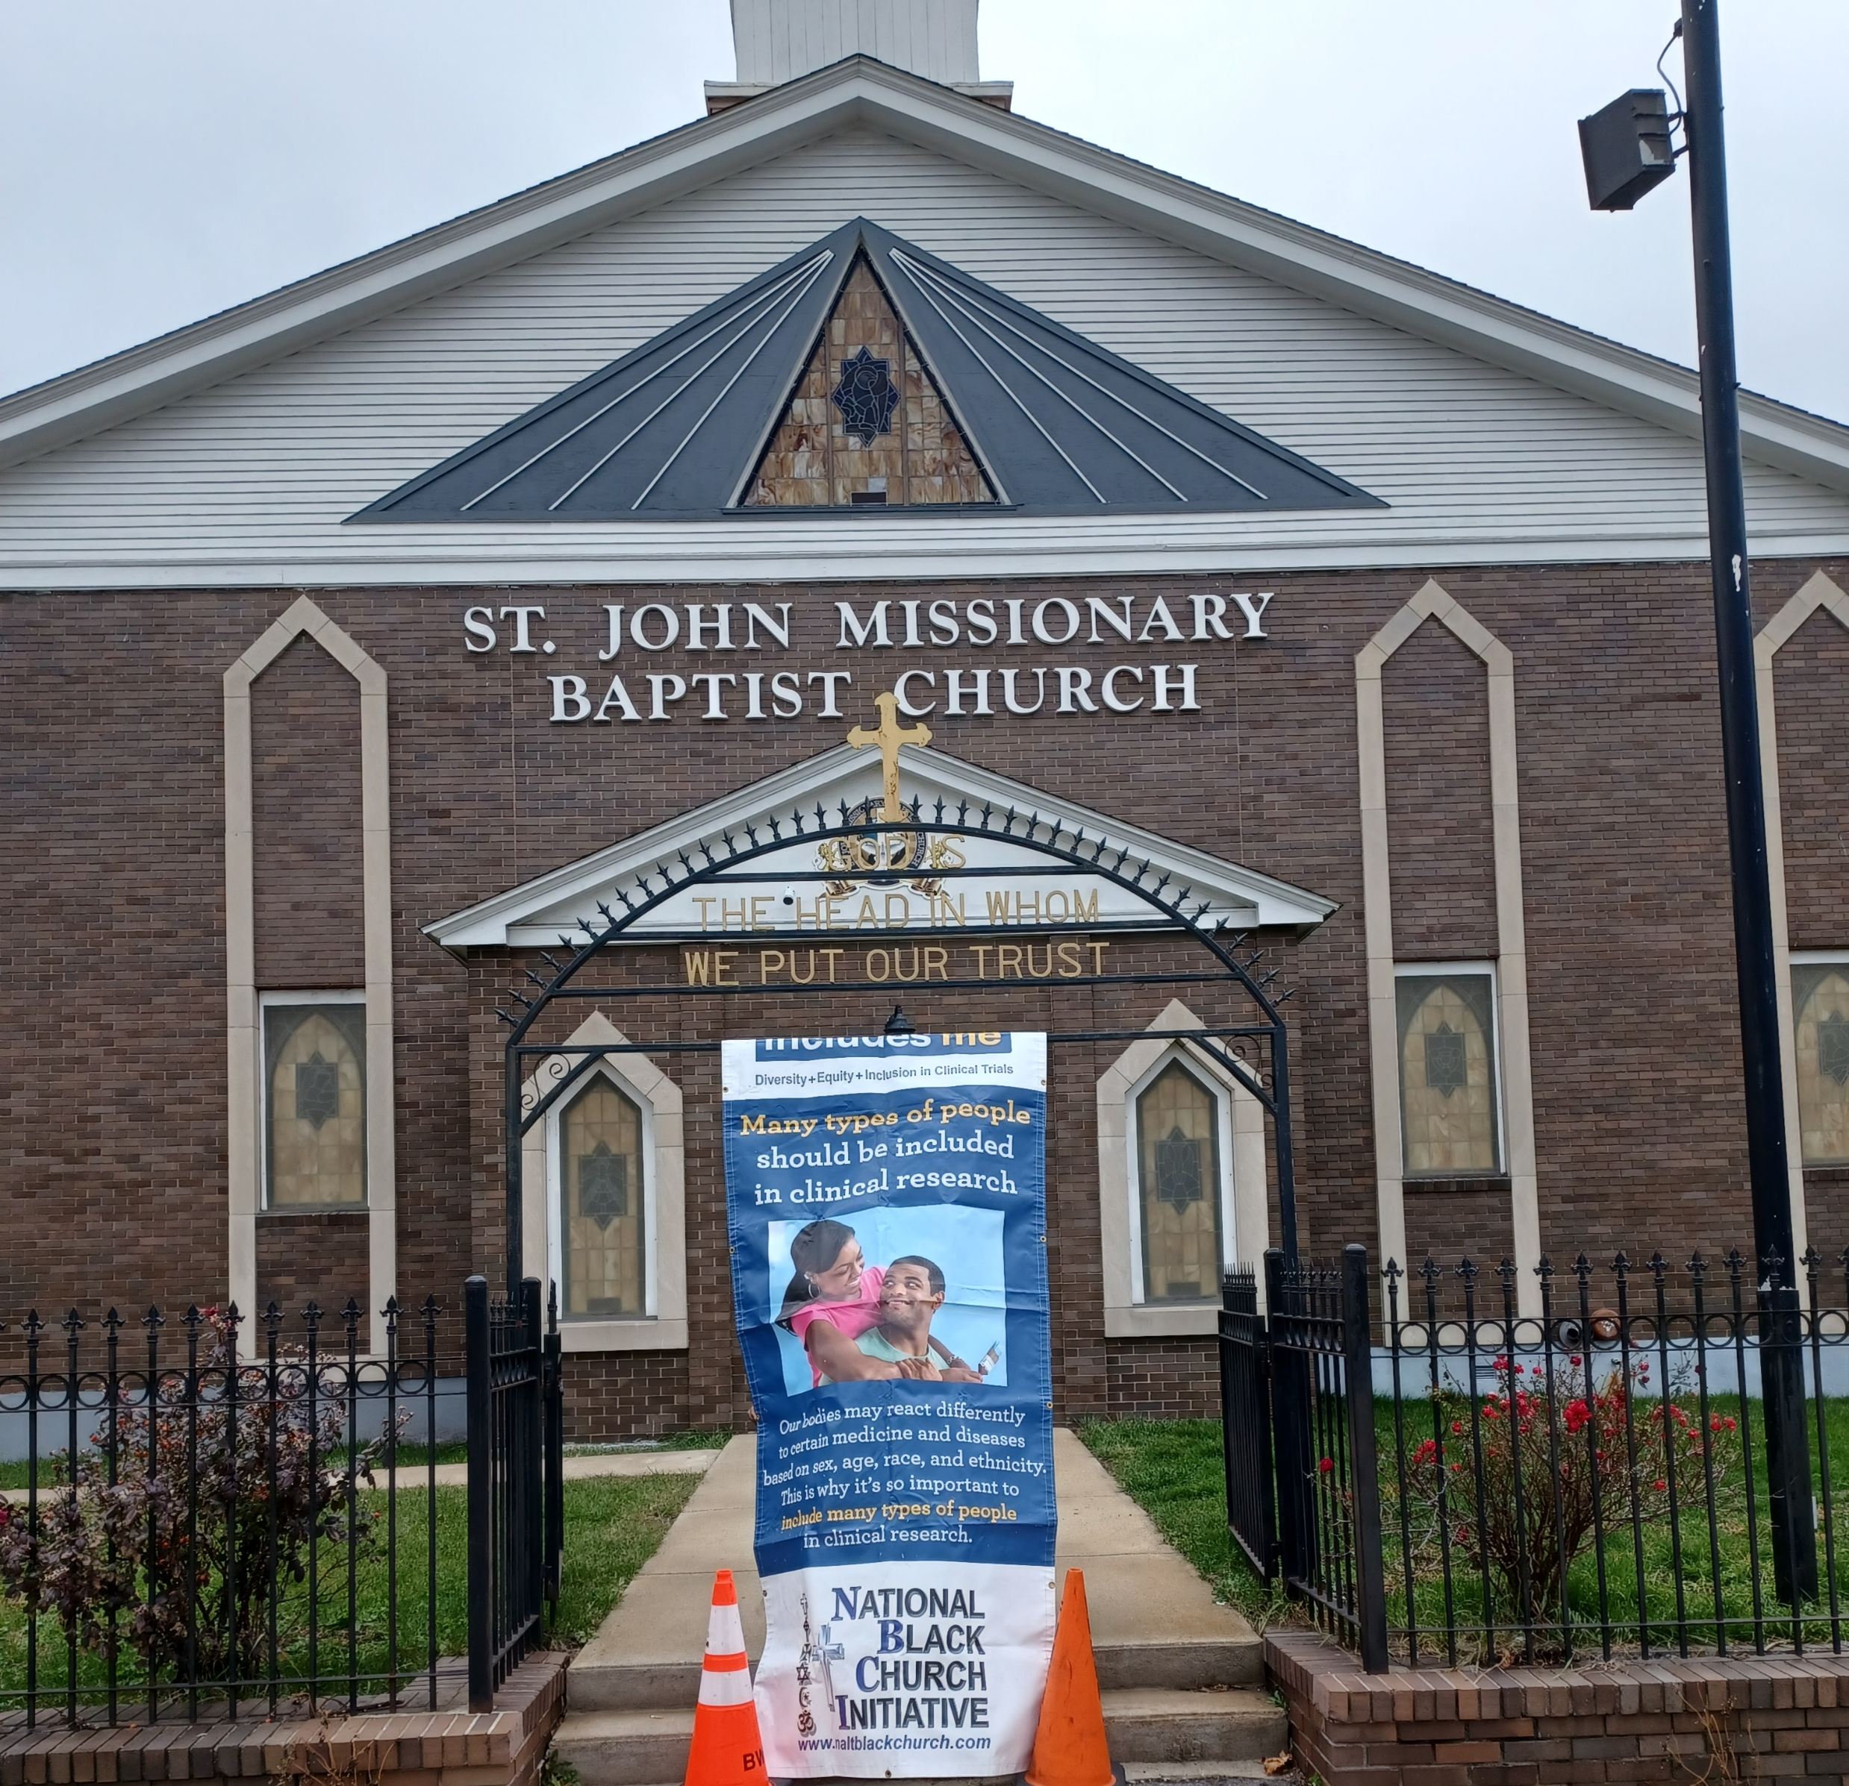
Benefits for Pharma Companies

Slide 23
Benefits for Pharma Companies (1)
Each company name and logo will go on the NBCI Clinical Trial written material as initial partners to our 27.7 million members.
There will be additional access and benefits given to those companies who increase their support at a higher level than the initial assessment like advertise their clinical trials on NBCI website and social media platforms
The initiative will enhance the companies present diversity, equity and inclusion in clinical trial programs.
This initiative will have an immediate impact of the lives of 130,000 African American and Latinos.
Each company will also have access to NBCI clinical team for consultation.

Slide 24
Benefits for Pharma Companies (2)
Each company will be given a day long educational session of NBCI National Clinical Strategic Plan with their key department heads each year of support.
The company name and logos will go on the new NBCI Clinical Trials Website as Initial Partners.
Each company representative will serve on NBCI BIO/Pharma High level Clinical Trial Advisory Committee with twice yearly meetings to be held

Slide 25
Benefits for Pharma Companies (3)
The Advisory Committee will help the initiative strengthen its’ outreach implementation and focus in light of sharing progress reports
Each company will be allowed to engage and talk about recruitment of their clinical trials.

Slide 26
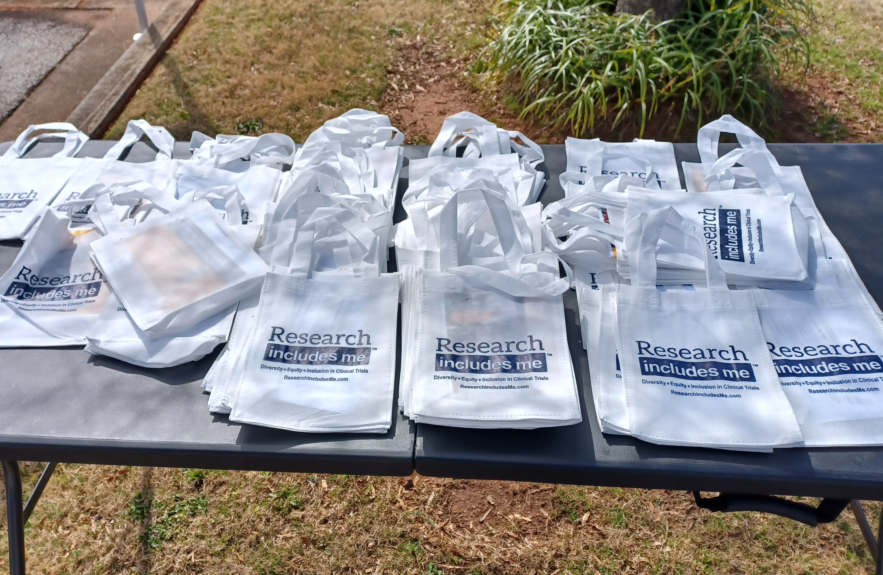
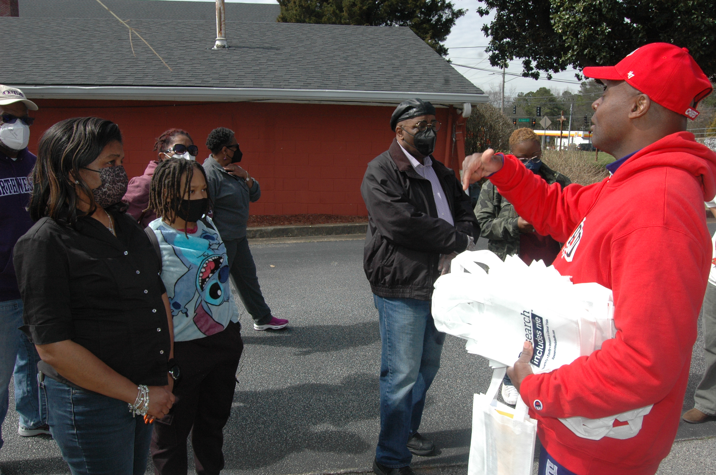
What Does the Future Look Like?
Outcomes for the First Four years

Slide 27
NBCI Educational Approach… The First Four Years
ALIGNMENT: This educational plan aligns with FDA requirements for diversity in clinical trails. Based upon NBCI demographics and membership. This initiative will be the largest educational clinical trial effort for African American and Latinos
IMPLEMENT: This initiative calls for implementing the best practices to date, utilizing data from the 25,000 low-income evaluators to launch a nationwide clinical trials educational modules.

Slide 28
Targeted Outcomes for the First Four Years
NBCI will seek outcomes associated with the implementation of the comprehensive educational approach.
Quarterly data will be shared concerning the outcomes below.
The targeted outcomes will focus on the use and impact of weekly educational sessions, “Train the Trainers” methodology, social media campaigns, development of literature, advertisement in African American and Latino media outlets and virtual seminars with experts.
The use and impact of the targeted outcomes will seek annual 10% increase once the baseline is established.

Slide 29
NBCI Educational Approach… The First Four Years
Four educational modules are found on NBCI clinical trial website, provide practical framework for understanding health and wellness strategies.
Here are the identified educational modules:
What are the issues surrounding clinical trials and the Black and Latino communities?
What is a clinical trial?
What are the benefits and risks? What are the safeguards?
How to safely enroll and participate?

Slide 30
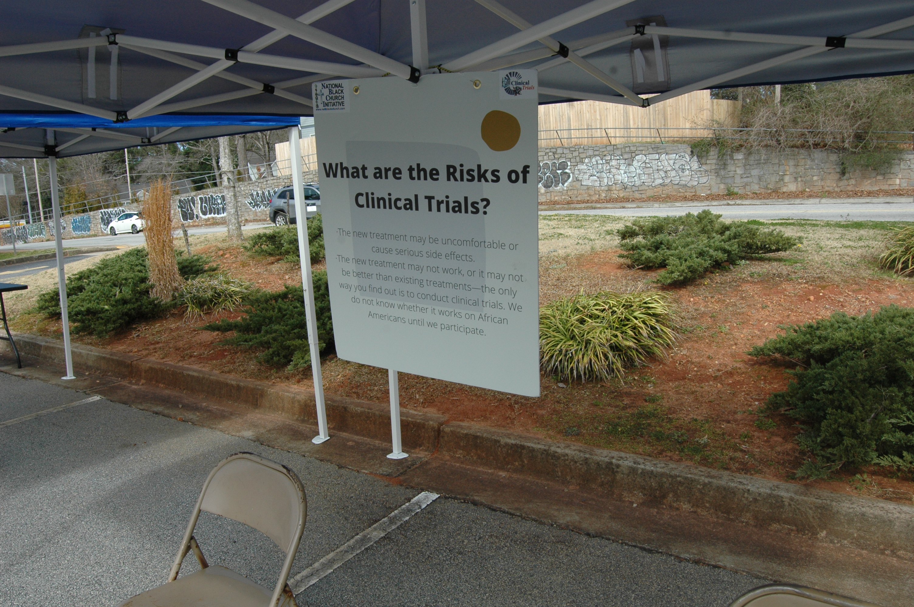
Appendix & Back Up

Slide 31
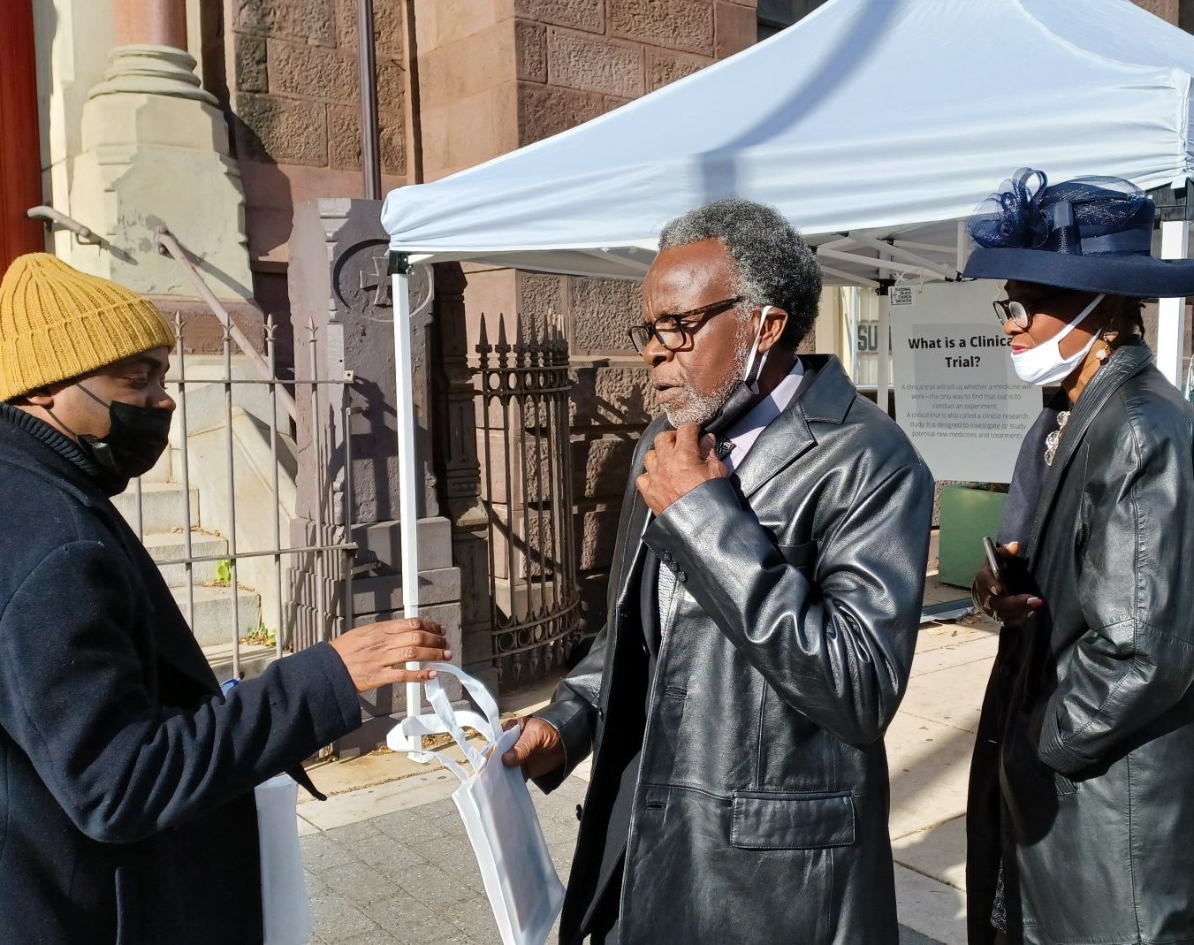
Detailed Tasks & Budget Allocation
2024-2027

Slide 32
How We Plan to Achieve Our Educational Goals
Implementation of the largest Trainer of Trainers Clinical Trials Program in for African-Americans and Latinos
Utilization of its 42 physicians-led clinical teams to train our health corps members and others to provide annual clinical trial education to our 27.7 million members in every region of the country.
Enactment of our 12-member NBCI Literature Review Committee to focus on the literature involving the educational development of various health topics.

Slide 33
The First Four Years: Tasks
2024
Hire new staff members and training.
Meet with sponsors individually for briefing and collaboration.
Produce written results of the 25,000 low-income new clinical trials website evaluation.
Activate NBCI Literature Committee to create a brochure on clinical trials and the African American and Latino community.

Slide 34
The First Four Years: Tasks
2024
Launch “Train the Trainer” seminars in Oakland, Detroit, Atlanta/Savannah and New York.
Launch social media /marketing program to promote https://blackchurchclinicaltrials.com/index.html.
Conduct program seminar on the impact of the new drug weight loss and Alzheimer’s Disease and the communities served.

Slide 35
The First Four Years: Tasks
2025
Hire new staff members and training.
Meet with sponsors individually for briefing and collaboration.
Activate NBCI Literature Committee in create a Clin-news(1-page newspaper) on clinical trials and the African American and Latino community.
Print and distribute Clin-news to twenty-five cities.

Slide 36
The First Four Years: Tasks
2025
Launch trainer of training seminars in Los Angeles, Chicago, Miami and New Jersey.
Launch social media /marketing program to promote https://blackchurchclinicaltrials.com/index.html.
Conduct program seminar on how to effectively communicate with African American and Latino patients.

Slide 37
The First Four Years: Tasks
2026
Hire new staff members and training.
Meet with sponsors individually for briefing and collaboration.
Activate NBCI Literature Committee to write and produce an HD video in a 4-part script how to effectively communicate with Black and Latino patients
Print and distribute Clin-news to twenty-five cities

Slide 38
The First Four Years: Tasks
2027
Launch trainer of training seminars in an additional 10 cities.
Launch social media /marketing program to promote https://blackchurchclinicaltrials.com/index.html.
Conduct program seminar on the newest drug and the impact upon our communities served.

Slide 39
Proposed Budget Allocation
Personnel 22%
Education and Outreach 22%
Overhead 17%
Social Media 7%
Public Policy/Seminars 6%
Technology Compliance/Maintenance 6%
Clinical Consultants 5%
Marketing/Publication( Clin-news) 5%
Liability Insurance 5%
Legal/Accountant 3%
Other 2%

Slide 40
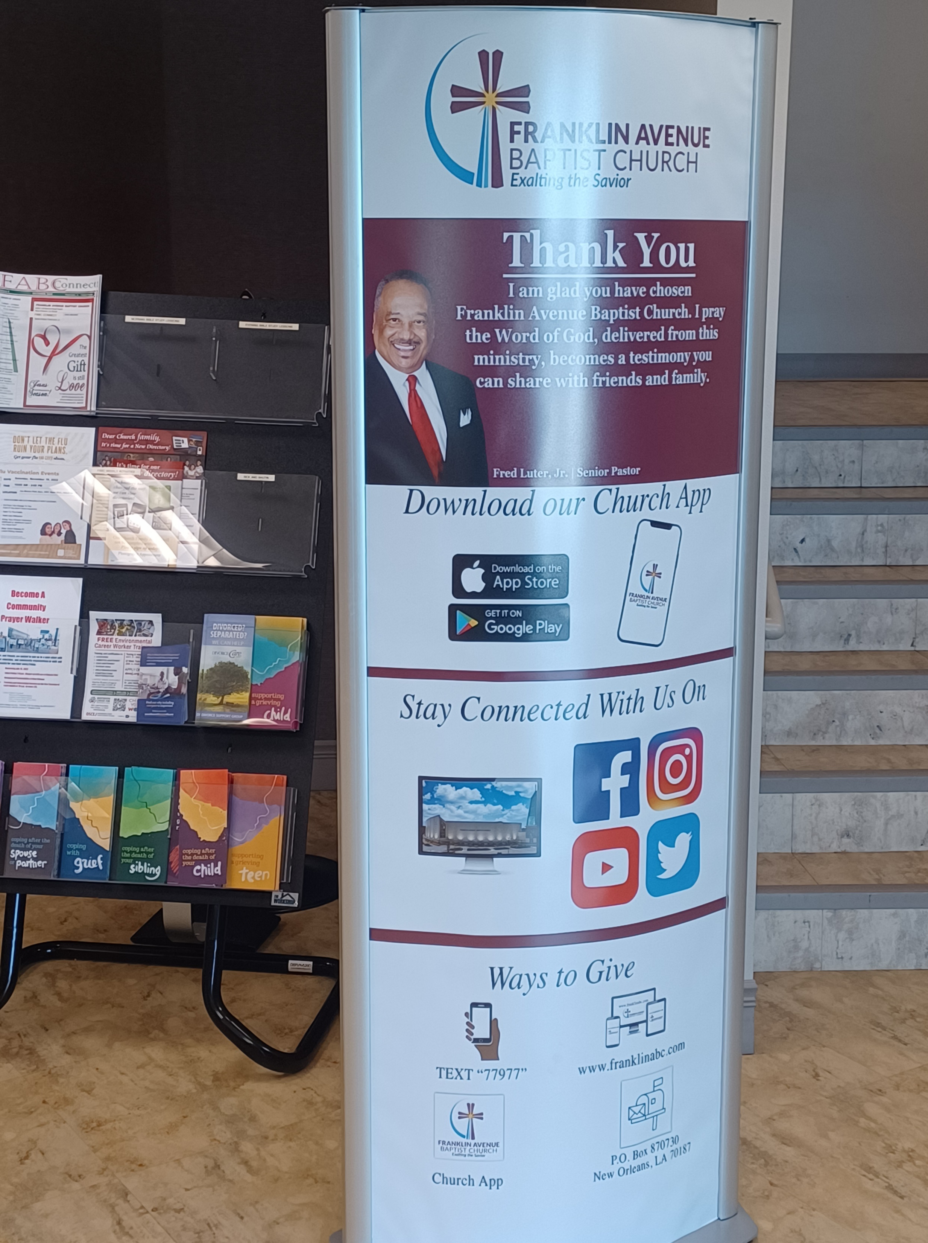
Additional Resources on NCBI

Slide 41
Why NBCI: Infrastructural Capacity for Implementing Programs
NBCI is an expert in the areas of health education, outreach, messaging, patient advocate and patient education to the Black and Latino communities.
NBCI has created and implement University-based Clinical Trail Day Field Trip long seminars
blackchurchclinicaltrials.com/field_trips_gen.php
NBCI has produced over 40 videos on clinical trials.
NBCI has had a successful working relationship with BIO over the past six years.

Slide 42
NBCI Successful Clinical Programing Examples
COVID Success Story with Shannon https://youtu.be/5MNxH4Kh4C8?si=W4yXBZWhLNJy0py3
Promotion of Vaccine with the Mayor of Charlotte, North Carolina https://youtu.be/oL9_qwaJl-w?si=jHKKf3v5pEGXqQJW
Black Churches Work to Boost Baltimore Vaccination Rates https://www.wypr.org/wypr-news/2021-09-06/black-churches-work-to-boost-baltimore-vaccinationrates
Baltimore Vaccination Campaign https://www.youtube.com/watch?v=3PzBYIZCOrg&t=34s

Slide 43
NBCI Successful Clinical Programing Examples
NBCI’s Publication of VACCNEWS https://www.naltblackchurch.com/health/pdf/vacc-news0612221.pdf
NBCI Launched Children’s' Vaccination Program in Savannah, Georgia https://www.facebook.com/NBCIonline/videos/970551947158686/
Publish A article in JAMA of NBCI successful program methodology https://www.naltblackchurch.com/health/covid-19.html
Wrote A Press Release defending Dr. Fauci leadership https://www.naltblackchurch.com/health/covid-19.html

